Slide 1
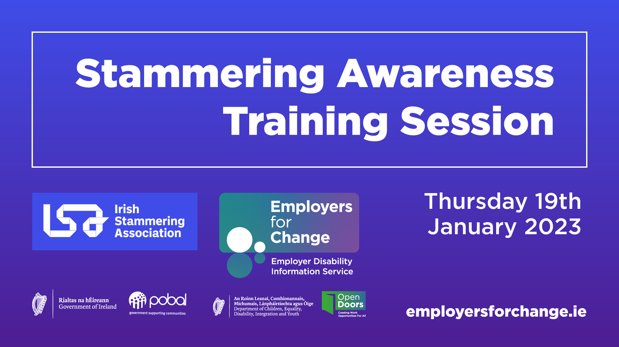
Stammering Awareness Training Session

Slide 2
‘Being mindful of candidates who stammer’
Notes:
Who we are
Introduce the organisation & Self

Slide 3

Outline Of Session
Understanding candidates who stammer
Challenges for someone who stammers
Creating a stammering inclusive workplace
How best to support someone who stammers in interviews
Moving forward
Q&A

Slide 4
Stammering
Also known as stuttering and/or dysfluency.
A “disruption to the timing and flow of speech when someone is talking”.
Speech disorder that is multi-factorial in origins: Genetic, neurological, psychological and environmental elements.
Involuntary loss of control, which is variable in its nature
Approximately 5% of children
  Typically develops when learning language
  Between 2-6 years of age
1% of adults
4:1 male:female ratio (4:3 in childhood)
Notes:
JL

Slide 5
Cluttering (in brief)
Different to stuttering, but in some ways, related.
Rapid and /or irregular speaking rate.
Reduced awareness of own rate of speech. The speaker may try to “catch up” on their speech when they notice their speech rate is too fast.
Disrupted language planning resulting in confusing, disorganized language or conversational skills.
Sounds like: “too fast” based on an overall impression or actual syllable per minute counts. Sounds “jerky” Pauses are too short/ too long or inconsistent.
Temporary improvement when asked to “slow down” or “pay attention” to speech – different to stammering.
Mispronunciation or slurring of speech sounds or deleting non-stressed syllables in longer words (e.g., “ferchly” for “fortunately”).
See: www.toofastforwords.com
Notes:
There’s a video linked in here which may be useful to watch https://www.mnsu.edu/comdis/ica1/papers/kissagizlisc.html

Slide 6
Characteristics of stammering
Complex and variable.
Primary features
  blocks
  re-re-repetitions
  prrrrrrrrolongations
Secondary behaviours
  Loss of eye contact
  Starter / filler words – em, ah, actually, you know
  Body movements – hands, legs – distractions
  Tension and struggle
  Reactions to primary behaviours
Avoidance
  Words, Sounds, People, Situations, Life?
Negative thoughts and feelings
  Fear, shame, guilt, “what is that person thinking?”
Notes:
JL

Slide 7
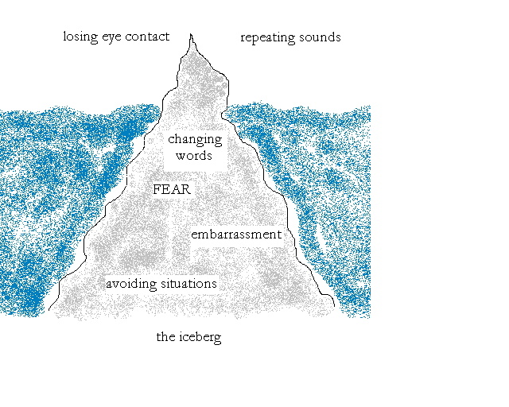
Sheehan’s iceberg
Notes:
Nature of stammering – overt / covert features
Impact of stammering and linking in to iceberg idea
Continuum of botheredness

Slide 8
Sheehan’s Iceberg Explained
Stuttering may be likened to an iceberg, with the major portion below the surface. What people see and hear is the smaller portion; far greater, and more dangerous and destructive, is that which lies below the surface, experienced as fear, guilt, and anticipation of shame.
For an adult or an adolescent mature enough to tolerate it, public presentation of the self as a stutterer has major therapeutic effects. The portion of the iceberg exposed to the sunlight of public view melts away more quickly (Sheehan, 1975)

Slide 9

Describing stuttering…
“a temporally distorted sound and the speaker’s reaction thereto” (Van Riper, 1982:17)
overt and covert features of stuttering
“those who appear to stutter in their heads not their mouths” (1973:31)
Botheredness cp. severity
Notes:
JL

Slide 10


Images of Glasses
Notes:
JL

Slide 11

Stammering and Avoidance
Avoidance
Theory of avoidance – how we see / don’t see avoidance e.g. Cup of tea vs coffee
Levels of avoidance;
  sounds, words, situations, feelings, relationships, self-role: ego-protective
Avoidance of going for jobs / interviews / opportunities – life
Levels are intertwined and not necessarily sequential
Notes:
JL

Slide 12
Challenges for someone who stammers
As a vocational barrier
…It has been found that many employers hold negative attitudes towards people
who stammer and this can impact on the likelihood of successful recruitment or
promotion. Recent research has indicated that people who stammer face daily,
casual discrimination at work, that the normal recruitment process with
interviews militates against them, and that they often do not achieve their
potential but ‘settle’ for menial jobs with little communication demands.
– “Understanding Stammering: A Guide For Employers”, 2017, Employer
Network for Equality & Inclusion and the British Stammering Association’s (Stamma)
Employer Stammering Network
Notes:
GD

Slide 13
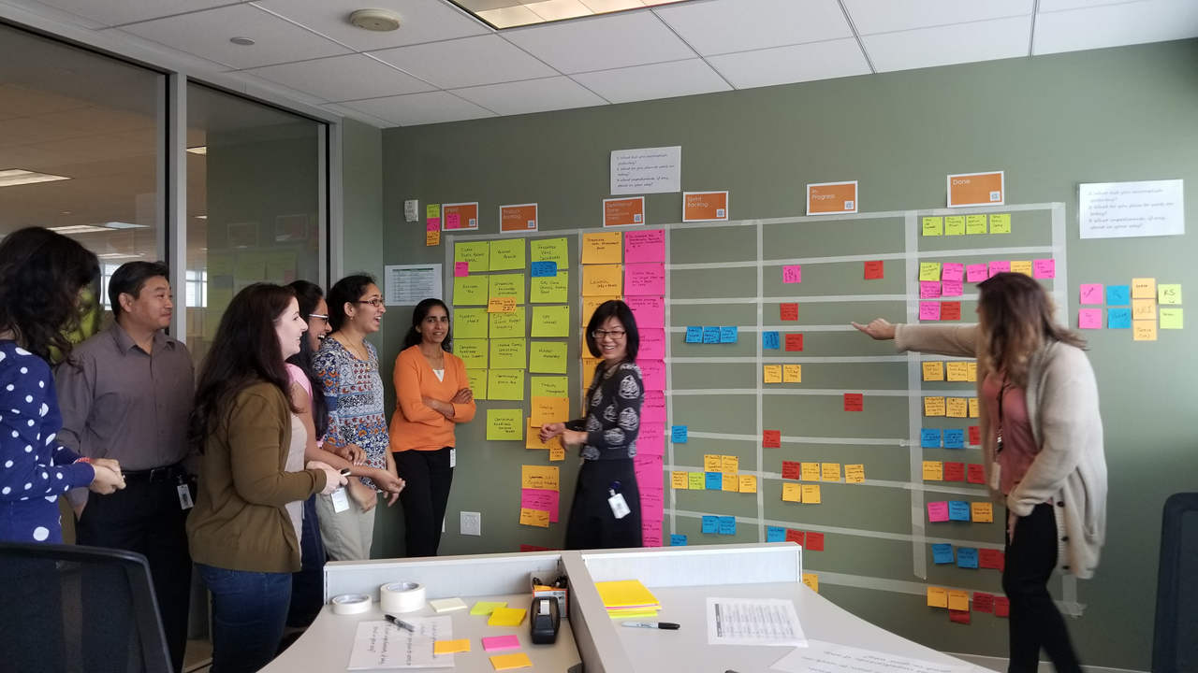




Challenges for someone who stammers continued…
Notes:
GD
Time pressure

Slide 14
Creating a Stammering inclusive workplace
Application Process
  Excellent communication skills
  Describe the role not the person
  Space for disclosure
    Not a disability
  Don’t assume that stammer precludes someone from carrying out a role
Interview
  Reasonable accommodations
    Additional time
  Train interviewers
Onboarding
  To disclose or not to disclose…..and to who!
Promotion

Slide 15
How best to support someone who stammers in interview
Maintain eye contact
Don’t complete their sentences – don’t invite them to “take your time”, “relax”.
Give them additional time
Be patient and understanding
Allow silence
As a ‘coach’, being open to explore what can help someone. Even giving support can reduce the impact and increase a person’s confidence
Notes:
GD

Slide 16

Case studies
Experiences
Perceptions
Questions
Notes:
JL lead with feedback on cases

Slide 17
Moving forward
Recruitment Process
  ‘ Do you require additional time at interview to accommodate stammering/ dysfluency?’
Research
  Irish and international potential
  Employment perspective of stammering and the workplace
Notes:
GD
Research- JL Ramble!

Slide 18
How you can get involved
Share our information with your staff
  Support groups, social events, children and family support.
Mentoring
Volunteering

Slide 19
Thank You

